Slide 1
Bounds on Lorentz Invariance Violation
by Tahir Kamcili

Slide 2

Short topic overview
Quantum theory and gravity merge at E_{pl} (≈ 1.22 * 10^28 eV)
Lorentz invariance violation
Modification of vacuo dispersions relation
Prediction of effects on much lower scale
Effects on:
γ-γ pair-production
absorption of γ rays
time of flight of γ rays (paper)
Notes:
- Expectance of energy-dependent delay in arrival time
- n modification order
- subluminal or superluminal for s = +1 or s = −1
- information on the comoving distance between the source and the detector D_n(z)

Slide 3
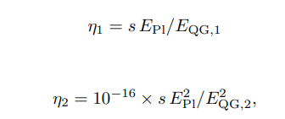
Linear and quadratic modification possible
No variation at (null hypothesis)
Notes:
Planck energy (EPl ≈ 1.22 × 1019 GeV)
unknown theory of quantum gravity (QG)

Slide 4
Observations on
Gamma ray bursts (GRB, paper)
active galactic nucleuses
Crab pulsar
MAGIC (Cherenkov telescopes) detection of a GRB
GRB 190114C: January 14, 2019 at 20:57:03 UTC
E = 0.3 – 1 TeV
Notes:
- MAGIC obersvation of GRB 190114C (TeV source)
- Only reasently a detection of TeV
- GRB are good source for high energies, but really hard to detected on very high energies (10^11 eV)
- Most distance source

Slide 5
Problems
Very high Energy γ rays get absorbed by the extragalactic background light
observed spectrum softer than intrinsic one
Measurements are a smooth power law
energy-dependent time delay can make problems
Model needed for maximum likehood
minimal approach
theoretical approach (based on multiwavelength observation)
Notes:
Power law expected
But energy-dependent time delay will result in an power law again

Slide 6
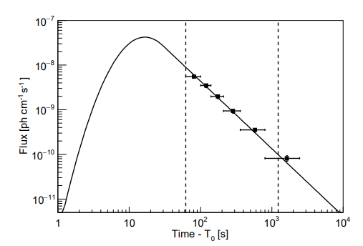
Notes:
full line represents the LC model
points represent the γ-ray flux measured in the 0.3–1 TeV energy range

Slide 7
Results
Minimal Approach theoretical model doesn’t suggest a time delay
Comparable to the null hyposis
Linear modification of the photon dispersion relation factor 4 lower than most constraining lower limits from other TOF methods
quadratic case more sensitive to the highest photon energies
Notes:
-

Slide 8
forward looking
Observed GRB was featureless
Observations of feature-rich (VHE) GRB could be more promising
would enhance the analysis sensitivity to LIV effects
Observations of AGN’s and Crab pulsars could also result in other results

